Slide 1

SQL Project Presentation
World Wide Energy Consumption
PRESENTED BY: D.ANJALI
INNOMATICS RESEARCH LABS

Slide 2
About Me:
I am Diddiga Anjali, a passionate data analyst with a strong interest in transforming data into actionable insights that support informed decision-making.
I have completed my B.Tech in Agricultural Engineering
LinkedIn : https://www.linkedin.com/in/diddiga-anjali-75212328a/
GitHub : https://github.com/DiddigaAnjali

Slide 3
Agenda :
Business Problem
Objective
ER Diagram
Schema Overview
Dataset Overview
Analysis
Key Insights
Conclusion

Slide 4
Business Problem:
Governments and international energy organizations maintain large volumes of energy-related data across multiple domains, including energy production, energy consumption, emissions, population, and economic output.
Using SQL queries, the project examines energy trends over time, compares economic growth with emission levels, and evaluates per-capita and ratio-based metrics to enable fair cross-country comparisons. The analysis supports data-driven insights into energy efficiency, sustainability, and policy effectiveness, helping stakeholders balance economic growth with environmental impact and energy security.
Objective:
To analyze global energy consumption patterns across regions and sectors.
To identify trends in energy usage over time and their key drivers.
To compare the consumption of renewable and non-renewable energy sources worldwide.
To assess the environmental and economic impacts of current energy consumption levels.
To support data-driven decision-making for sustainable energy policies and planning.

Slide 5
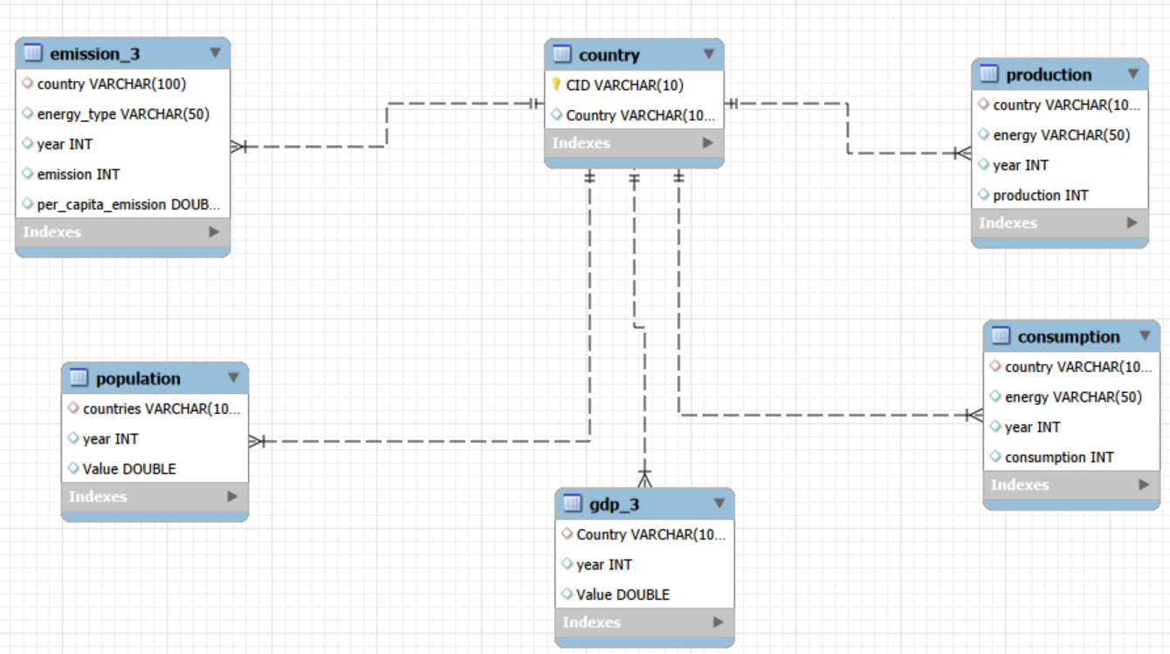
ER Diagram:

Slide 6
Schema Overview:
Database Schema – energydb
The energydb database consists of six relational tables
The country table is the central/master table
All other tables reference the country table using foreign keys
The schema supports integrated analysis of:
Energy consumption
Energy production
Emissions
GDP (PPP)
Population

Slide 7
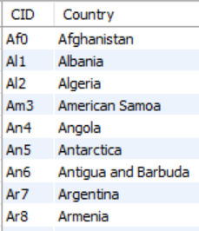
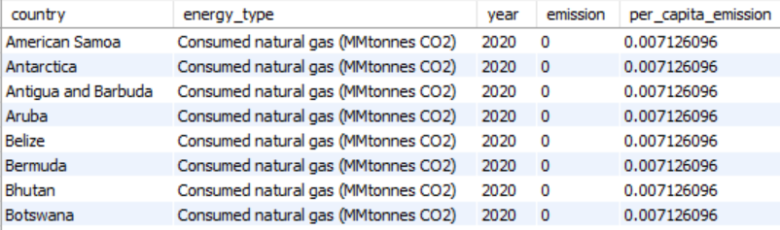
Dataset Overview:
The project uses a structured energy dataset stored in a MySQL database named energy, consisting of six interrelated tables. The country table serves as the central reference table, with all other tables linked via foreign keys.
1. Country (Central Table)
Stores unique country identifiers
Acts as the reference table for all other datasets
2. Emission Table
Contains emission consumption, type data by country and year
Linked to country via foreign key

Slide 8
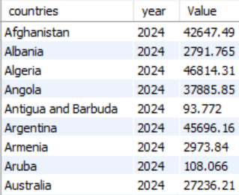
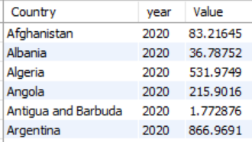
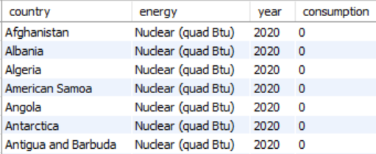
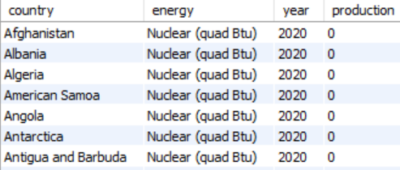
3. Population Table
Contains population statistics by country
Linked to country via foreign key
4. Production Table
Stores energy type and production statistics by country
Linked to country via foreign key
5. GDP_PPP Table
Represents economic indicators using GDP (PPP) values
Linked to country via foreign key
6. Consumption Table
Contains energy consumption data by country
Linked to country via foreign key

Slide 9
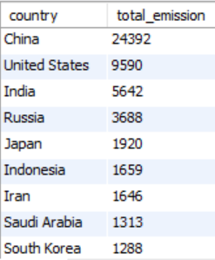
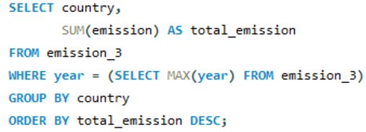
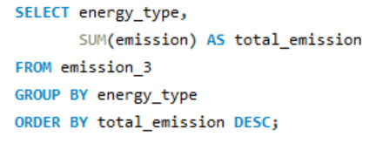
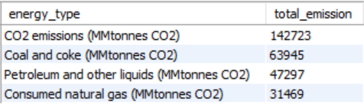
General & Comparative Analysis
1. What is the total emission per country for the most recent year available?
Query :
Output :
2. Which energy types contribute most to emissions across all countries?
Query :
Output :

Slide 10
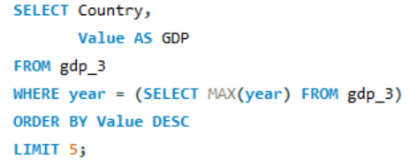
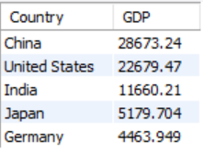
3. What are the top 5 countries by GDP in the most recent year?
Query :
Output :

Slide 11
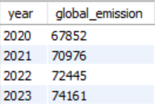
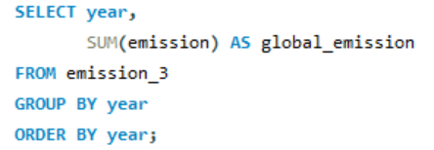
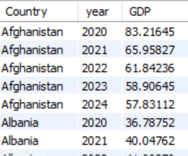
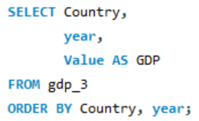
Trend Analysis Over Time
1. How have global emissions changed year over year?
Query:
Output:
2. What is the trend in GDP for each country over the given years?
Query:
Output:

Slide 12
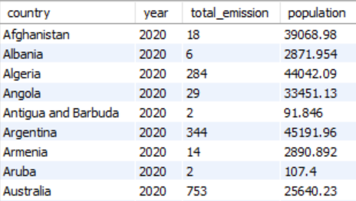
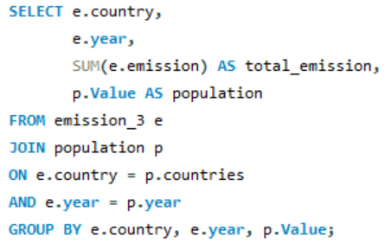
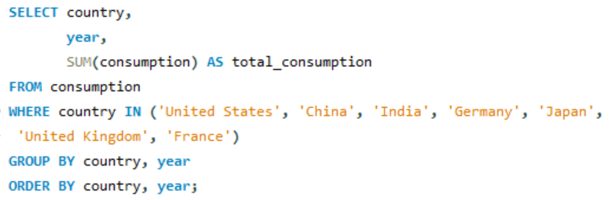
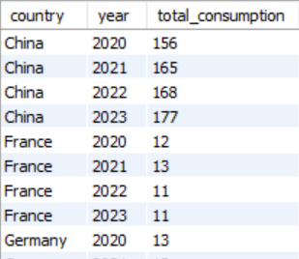
3. How has population growth affected total emissions in each country?
Query:
Output:
4. Has energy consumption increased or decreased over the years for major economies?
Query:
Output:

Slide 13
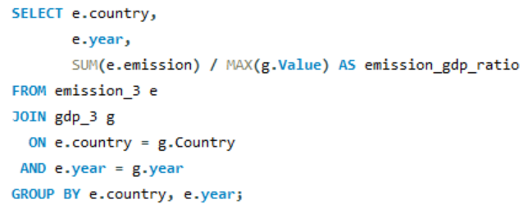
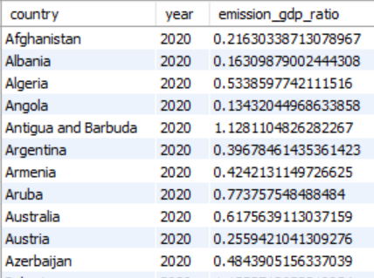
Ratio & Per Capita Analysis
1. What is the emission-to-GDP ratio for each country by year?
Output:
Query:

Slide 14
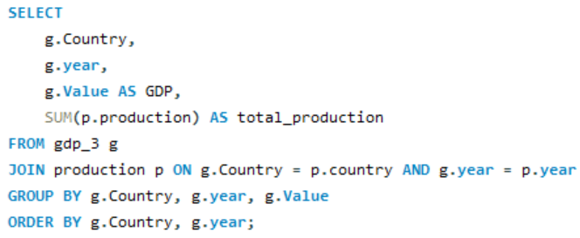
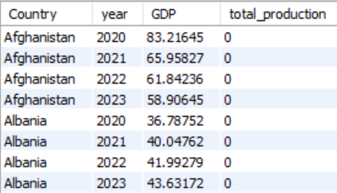
2. What is the correlation between GDP growth and energy production growth?
Query:
Output:

Slide 15
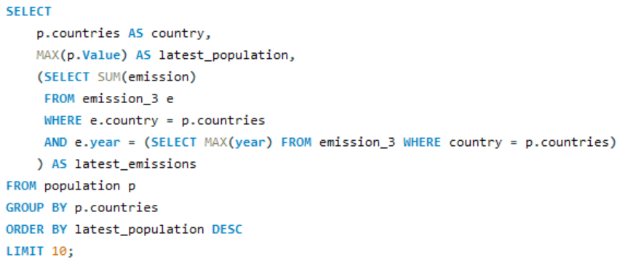
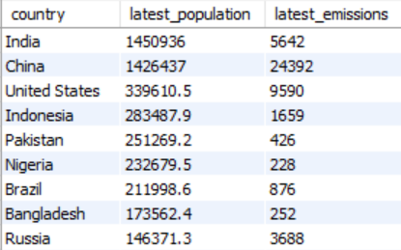
Global Comparisons
1. What are the top 10 countries by population and how do their emissions compare?
Query:
Output:

Slide 16
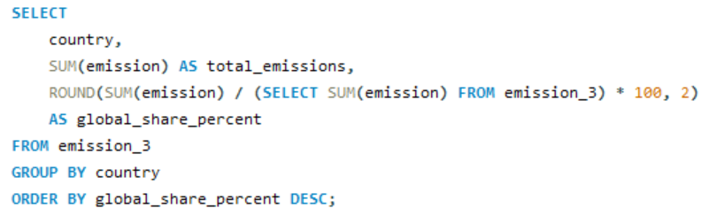
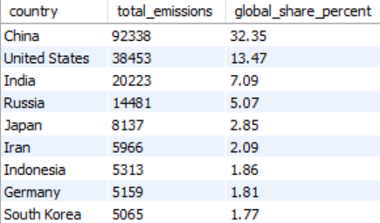
2. What is the global share (%) of emissions by country?
Query:
Output:

Slide 17
Key Insights :
Global emissions continue to rise, driven by increasing energy demand.
CO₂-based energy sources remain the dominant contributors to total emissions.
Economic growth (GDP) and energy consumption have increased across major economies.
Population growth is generally associated with higher total emissions.
Conclusion:
Population growth and economic expansion continue to drive higher total emissions, with a small number of countries responsible for a disproportionate share of global emissions. However, cross-country evidence shows that through energy efficiency improvements and adoption of cleaner technologies, it is possible to decouple economic growth from environmental impact.

Slide 18

Q & A

Slide 19

THANK YOU

